Slide 1
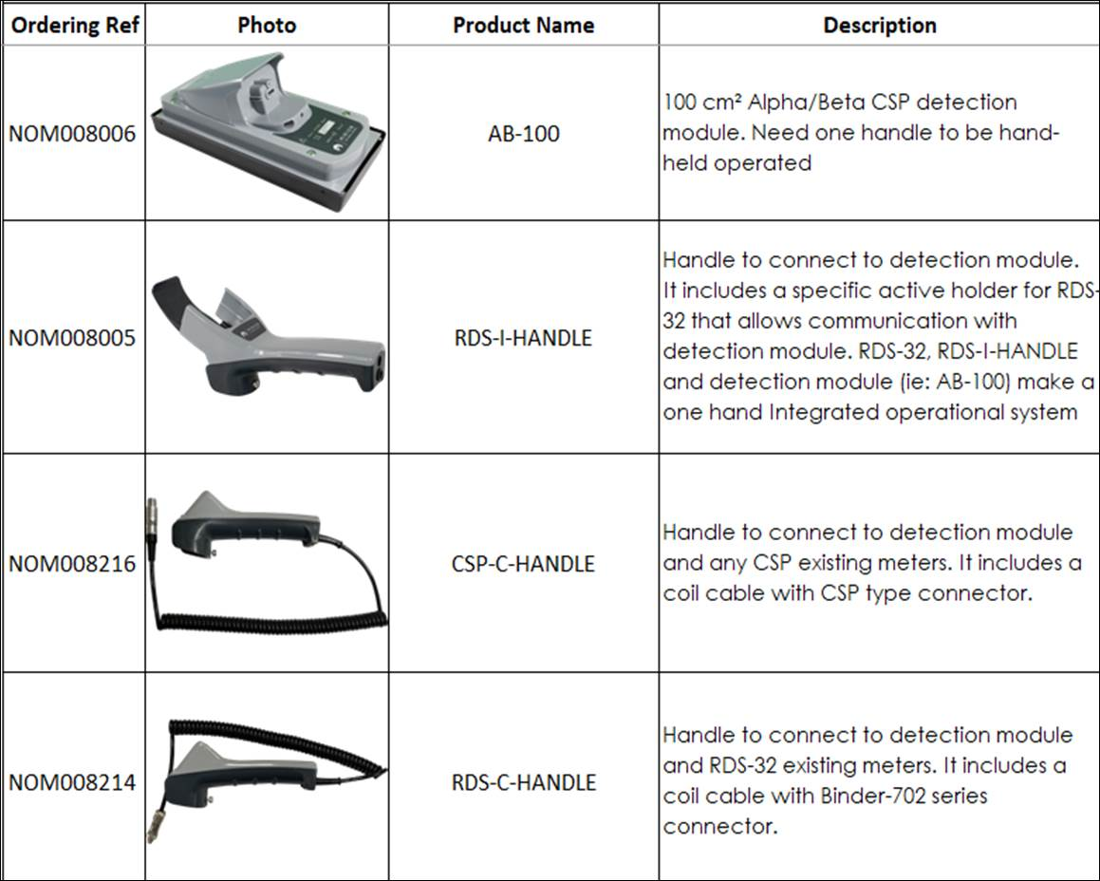
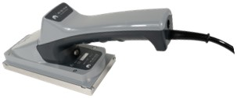
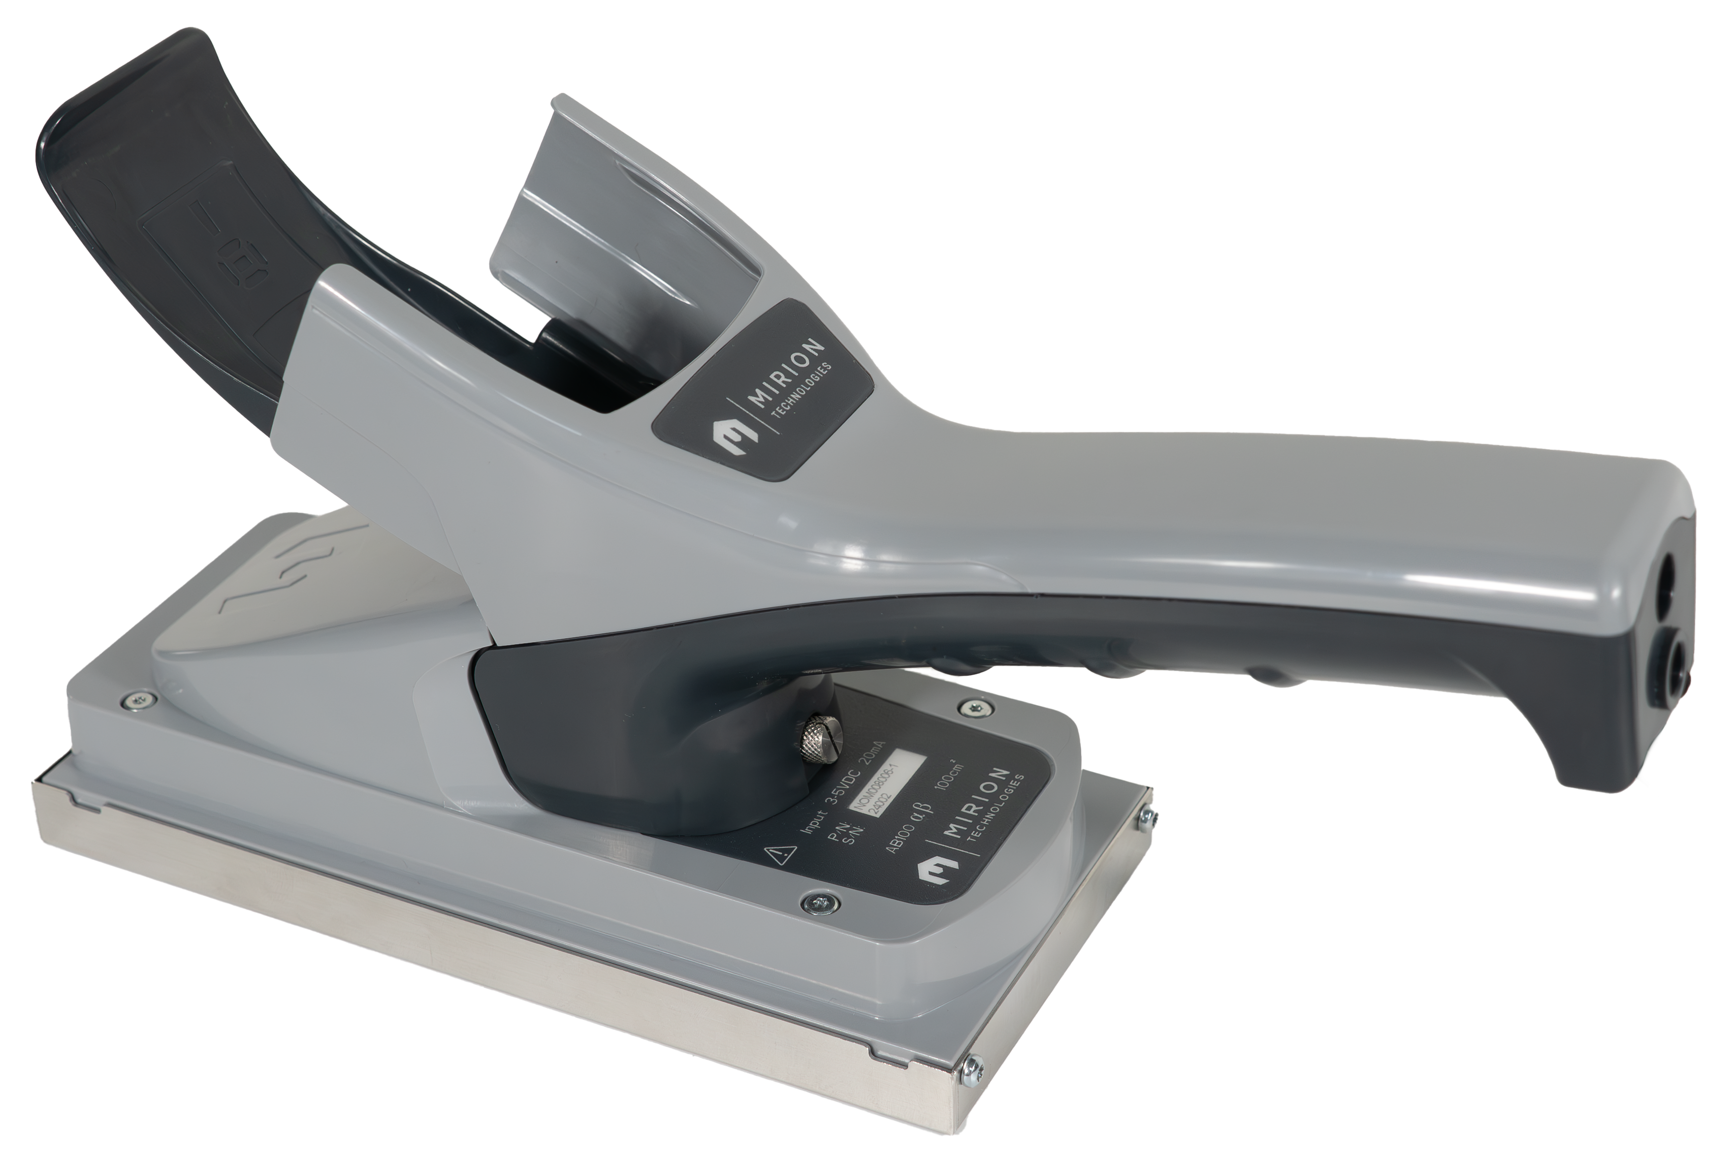
New products Introduction
CSPevo is almost ready with an anticipated launch planned for Mid-February 2025.

Slide 2
Product Description: The AB-100 probe is ideal for radiation protection teams and system integrators looking for a robust, reliable, and easy-to-integrate solution. It offers extensive application coverage while ensuring superior detection performance.
The AB-100 probe utilizes advanced light collection based on Mirion LightLink® technology, offering increased robustness and superior detection homogeneity. It is designed to withstand drops and mechanical shocks, ensuring exceptional reliability in demanding environments.
The AB-100 probe is compatible with different handles and can be connected to various host instruments, aligning with the environmental measurement conditions. These handles work either with a cable that matches a CSP meter or RDS-32 type connector, or with an integrated holder for RDS-32 without a cable. The integrated setup provides a convenient one-handed operation for most scenarios, while the cable-based handles are useful for measuring hard-to-reach areas where it is important to maintain visibility of the meter display.
Key Features:
LightLink Technology: Enhances light collection and robustness, reducing the risk of failure.
Detection Homogeneity: Over 80% detection homogeneity, ensuring reliable and consistent results.
USB-C Compatibility: Facilitates connectivity with third-party systems and calibration software
Improved Ergonomics: Lightweight and comfortable design for prolonged use without discomfort.
Compatibility with Existing CSP Systems: Allows for a smooth transition for current installed based.
Benefits:
Increased Robustness: The AB-100 probe is less fragile than technologies based on photomultiplier tubes (PMT), offering better equipment availability.
Quick Maintenance: Reduced downtime after maintenance thanks to technology that does not require light decay time.
Easy Integration: Compact size and low sensitivity to magnetic fields, facilitating integration into third-party systems.
Versatility: Different handle configurations to suit various applications, including self-frisking and on-site surveys.
SAB-100 vs AB-100 preliminary comparison →

