Slide 1
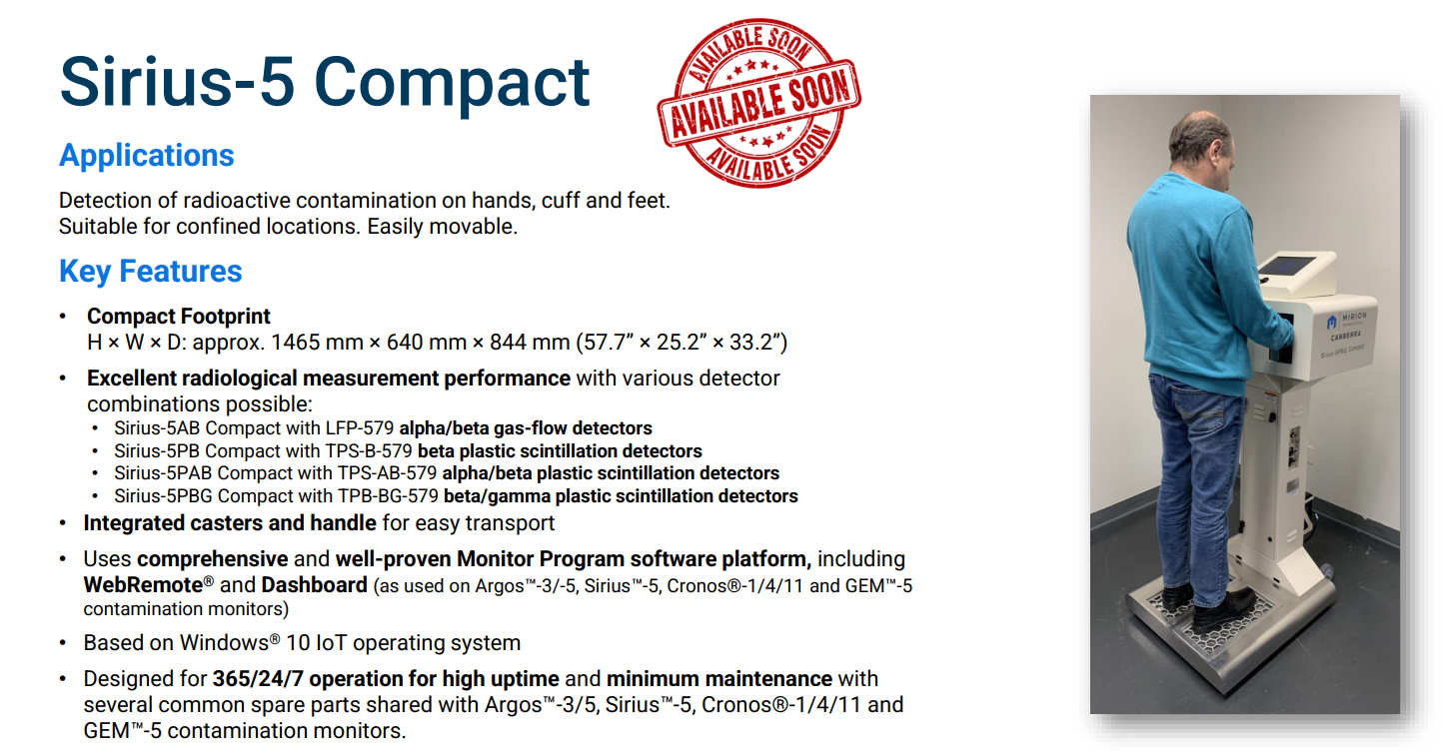
New product
LAUNCH : AUGUST 2024

Slide 2
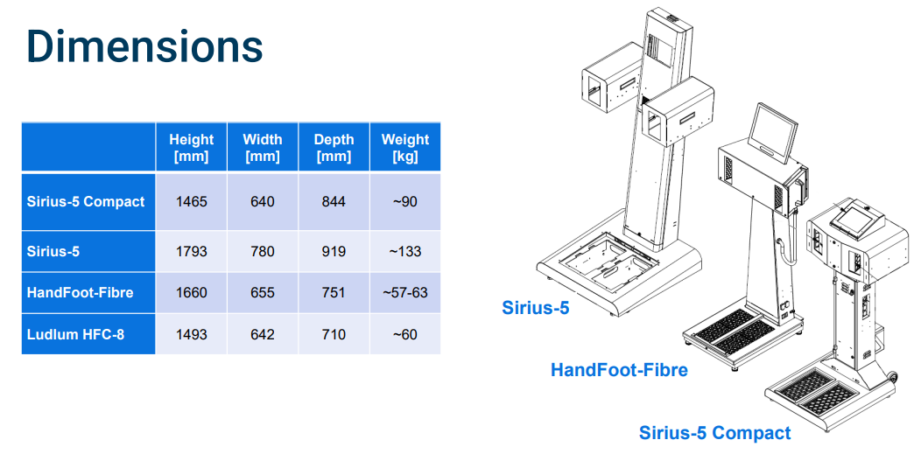
Sirius-5 Compact

